Slide 1
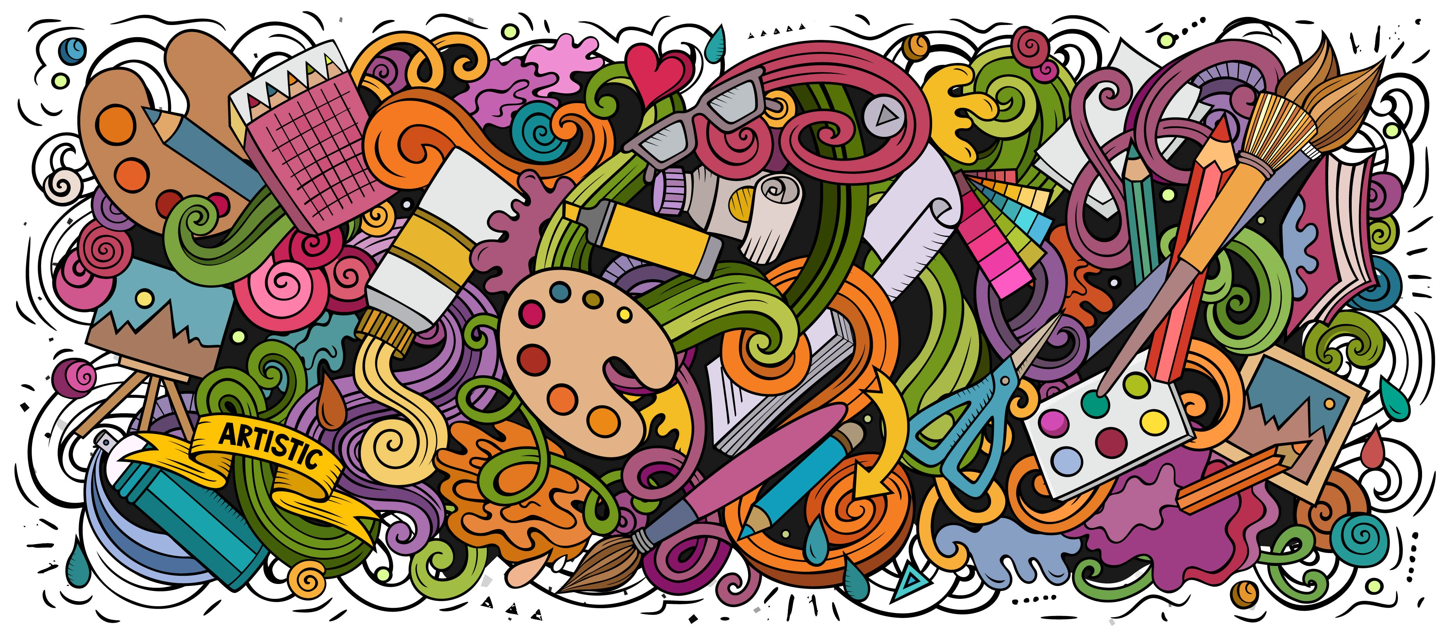
What is Art?
Art allows you to be creative.
To express your imagination
To create an object that is beautiful
Creativity = Knowledge + Imagination
What is art?

Slide 2
What is Art?
Artists understand the conventions of Art
Different styles
Different genre
Different techniques
What is art?

Slide 3
What is Art?
Artists mimic the work of others and the world around them
What is art?

Slide 4
What is Art?
Artists use their own experiences and imagination to create art
What is art?

Slide 5
What is Art?
Artists use art to express their feelings, emotions and ideas
What is art?

Slide 6
What is Art?
Artists try to get people to think about current news or ideas in new ways
What is art?

Slide 7
What is Art?
Artists experiment with using new materials and explore different ways of using these materials
What is art?

Slide 8
What is Art?
Artists create original and authentic artwork by combining different media and techniques
What is art?

